Slide 1
Undercover: Cooperation-based Routing Protocol for Cognitive Radio Networks
Supervised By:
Prof. Dr. Soheir Bassiouny
Prof. Dr. Mustafa ElNainay
Presented by: Arsany Guirguis
January 2017

Slide 2
Objectives
Discuss the motivation of this work.
Present the contributions of this work.
Discuss the details of the proposed algorithm.
Discuss the evaluation of the proposed algorithm.
Give directions for possible future extensions to this work.

Slide 3
Agenda
Introduction
Contributions
Related Work
Undercover: System and Mathematical Models
Undercover: Implementation Details
CSCR: Channel Selection Scheme for Undercover
Experimental Results
Conclusions and Future Work

Slide 4
Agenda
Introduction
  Cognitive Radio Networks (CRNs)
  Routing Protocols in CRNs
  Cooperative Communication
Contributions
Related Work
Undercover: System and Mathematical Models
Undercover: Implementation Details
CSCR: Channel Selection Scheme for Undercover
Experimental Results
Conclusions and Future Work

Slide 5
1.1 Cognitive Radio Networks (CRNs)
Spectrum is a limited but underutilized resource.
Federal Communications Commission (FCC) shows that average spectrum utilization ranges between 15% and 85% [1].
  Solution: CRNs.

Slide 6
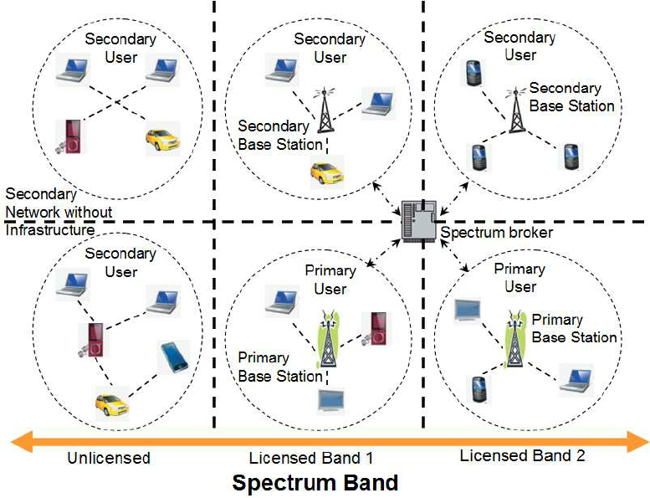
1.1 Cognitive Radio Networks (CRNs)
Two types of users in CRNs: Primary Users (PUs) and Secondary Users (SUs).
This allows for spectrum reuse by unlicensed users [2].
Notes:
Spectrum regulatory authorities are now working towards new regulations allowing for wireless spectrum reuse by unlicensed users [2].

Slide 7
1.2 Routing Protocols in CRNs
Several Routing Protocols were suggested in the context of CRNs [3], each with different criteria.
Most of them assume that SUs inside the interference range of an active PU cannot utilize the PU licensed channel during its active periods.
  Some assumed that this can happen only if SUs are very near from each other and use very low-power transmissions [4].

Slide 8
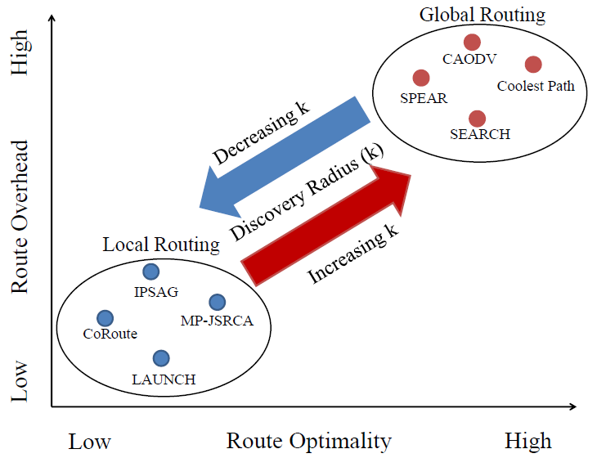
1.2 Routing Protocols in CRNs (cont’d)
Categorized into local and global approaches.
Notes:
Discuss the advantages and disadvantages of each approach in this slide.

Slide 9
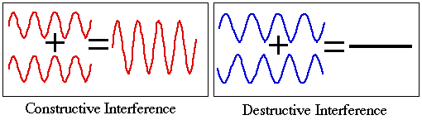
1.3 Cooperative Communication
Radio waves can constructively or destructively collide and affect one another.

Slide 10
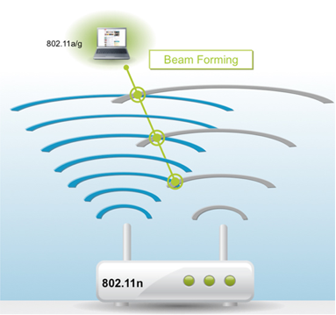
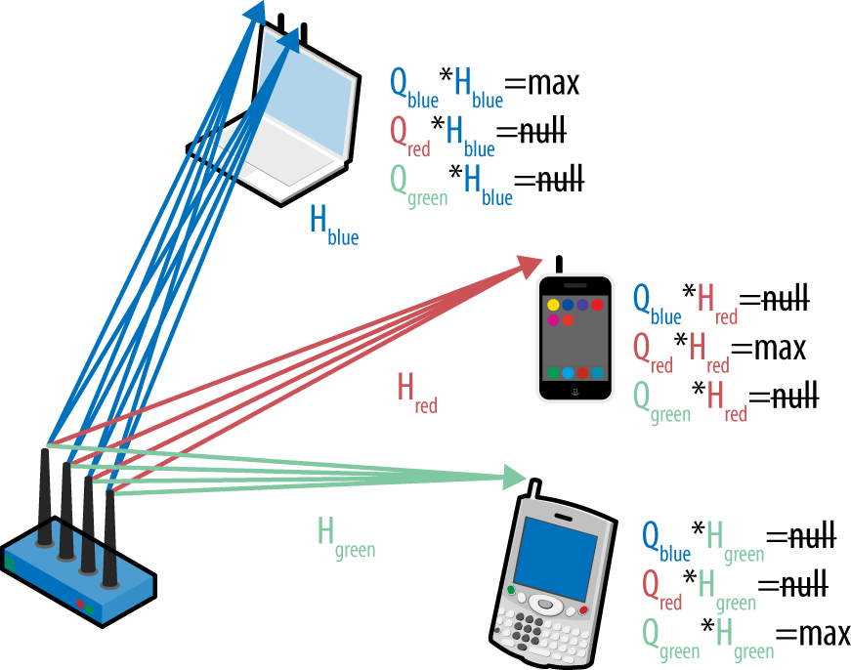
1.3 Cooperative Communication
This idea can enhance throughput [5] and enable simultaneous non-interfering transmissions [6].
Investigated in the scope of Wireless Networks [7] and Cognitive Radio Networks [8].

Slide 11
Objectives
Discuss the motivation of this work.
Present the contributions of this work.
Discuss the details of the proposed algorithm.
Discuss the evaluation of the proposed algorithm.
Give directions for possible future extensions to this work.

Slide 12
Agenda
Introduction
Contributions
Related Work
Undercover: System and Mathematical Models
Undercover: Implementation Details
CSCR: Channel Selection Scheme for Undercover
Experimental Results
Conclusions and Future Work

Slide 13
2. Contributions
Investigate the use of cooperative communications in route discovery phase.
Design Undercover, a cooperation-based routing protocol for CRNs. Its main idea is to null transmission at PUs through beamforming.
Investigate the possibility to enhance SUs flows throughput through cooperative diversity.
Investigate the tradeoff between maximizing the throughput and minimizing the interference.

Slide 14
3. Contributions (cont’d)
Develop a heuristic algorithm to reduce the exponential complexity of group construction algorithm.
Propose CSCR, a channel selection scheme to choose the best channel to send data through along with the group construction phase.
Evaluate Undercover and CSCR via NS2 against two other related protocols.

Slide 15
Agenda
Introduction
Contributions
Related Work
  Cooperative Communication
  Channel Selection Schemes
Undercover: System and Mathematical Models
Undercover: Implementation Details
CSCR: Channel Selection Scheme for Undercover
Experimental Results
Conclusions and Future Work

Slide 16
3.1 Cooperative Communication
Ding et al. use cooperative diversity to transmit data with higher capacity to maximize throughput [9].
Yi. et al. utilize beamforming by developing MAC layer protocol that maximize the received signal-to-interference noise ratio (SINR) among SUs with different power constraints and the Quality of Service (QoS) requirement of PUs [10].
DZP [11] considered using beamforming in the routing layer as a maintenance scheme.

Slide 17
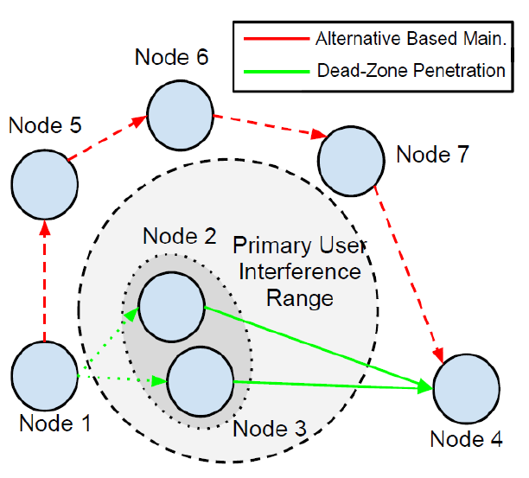
3.1 Dead Zone Penetration (DZP)
The main idea is to create a cooperative pair consisting of the affected node and one of its neighbors to null transmission at the active PU.

Slide 18
3.1 Cooperative Communication: The Need
These techniques were not utilized nor investigated in the route discovery phase.
Existing routing protocols are limited to the assumption that PUs and SUs cannot coexist with each other if both are active.
We use cooperative beamforming to allow for this coexistence.

Slide 19
3.2 Channel Selection Schemes
Channel assignment problem has been formulated as an optimization problem
  Joshi et al. target: using minimum transmission power [12].
  Hoang et al. target: maximize throughput of secondary network [13].
  Salameh et al. target: maximize sum-rate by all SUs [14].
Other publications use brute-force search using some metric to choose the best channel
  Lee et al. metric: the least end-to-end delay [15].
  Kim et al., metric: the least congested channel with PUs [16].

Slide 20
3.2 Channel Selection Schemes (cont’d)
Other publications put suggest some heuristics to choose the best channel
  Chen et al., in [17], propose a graph-based algorithm to choose the channel with the least interference on others.
  Li et al., in [18], solve cut-set problem to choose the most reliable SU path depending on PUs activities.

Slide 21
3.2 Channel Selection: The Need
We integrate channel selection in group construction phase, where all members of group should send data simultaneously on the same channel.
This restriction was not addressed before in the literature.
Requirements for the selected channel concerning PUs activities, SUs active flows, and switching delay were also taken into consideration.

Slide 22
Objectives
Discuss the motivation of this work.
Present the contributions of this work.
Discuss the details of the proposed algorithm.
Discuss the evaluation of the proposed algorithm.
Give directions for possible future extensions to this work.

Slide 23
Agenda
Introduction
Contributions
Related Work
Undercover: System and Mathematical Models
  System Assumptions
  Mathematical Model
  Routing Metric
Undercover: Implementation Details
CSCR: Channel Selection Scheme for Undercover
Experimental Results
Conclusions and Future Work

Slide 24
4.1 System Assumptions
PUs and SUs are stationary.
SUs know their locations, their neighbors’ locations, and the final destination location.
SUs can sense and detect PUs activities.
Slow fading wireless channels. Channel coefficients remain constant for short time T_{c}.
SUs can know the channel coefficients of both neighboring SUs and PUs.

Slide 25
4.1 System Assumptions (cont’d)
SUs communicate their control packets over dedicated Common Control Channel (CCC).
All nodes can operate with multiple channels. They can choose freely and independently the sending and receiving channels.
Channel switching delay depends on the difference between source and target channels.
Channels are non-overlapping.

Slide 26
4.2 Mathematical Model
Three main goals in modeling our problem:
  Null transmission at PUs.
  Enhance throughput of SUs flows.
  Minimize the interference resulted from cooperative group construction.
Increasing group size increases achievable throughput but increases interference as well. Tradeoff!!
We need to get routing metric that keeps this balance.

Slide 27
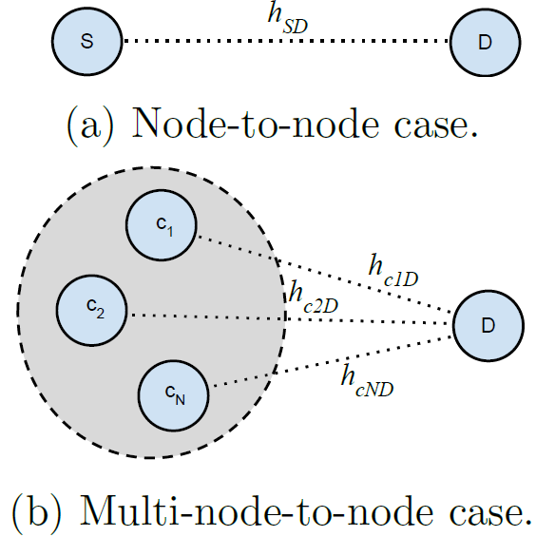
4.2.1 Capacity Calculations
We need to calculate the achievable capacity in two cases:

Slide 28
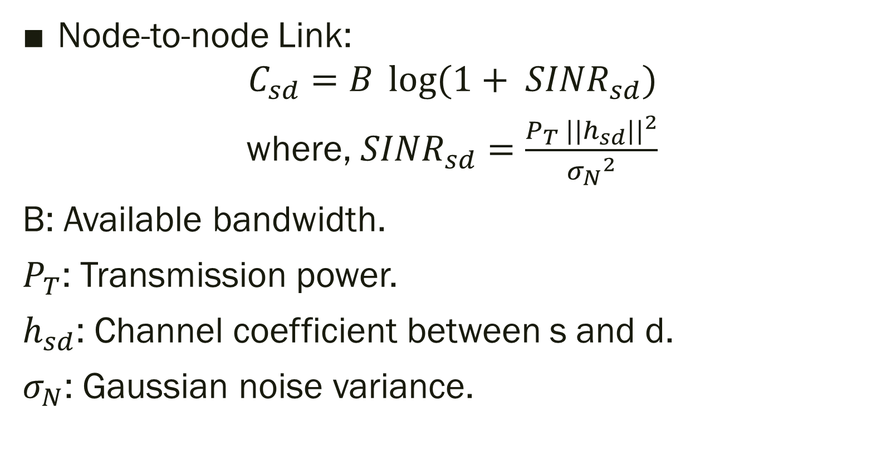
4.2.1 Capacity Calculations (cont’d)
Node-to-node Link:
$$C_{sd}=B \log{(1+ {SINR}_{sd})}$$
where, ${SINR}_{sd}=\frac{P_{T} {||h_{sd}||}^{2}}{{σ_{N}}^{2}}$
B: Available bandwidth.
$P_{T}$: Transmission power.
$h_{sd}$: Channel coefficient between s and d.
$σ_{N}$: Gaussian noise variance.

Slide 29
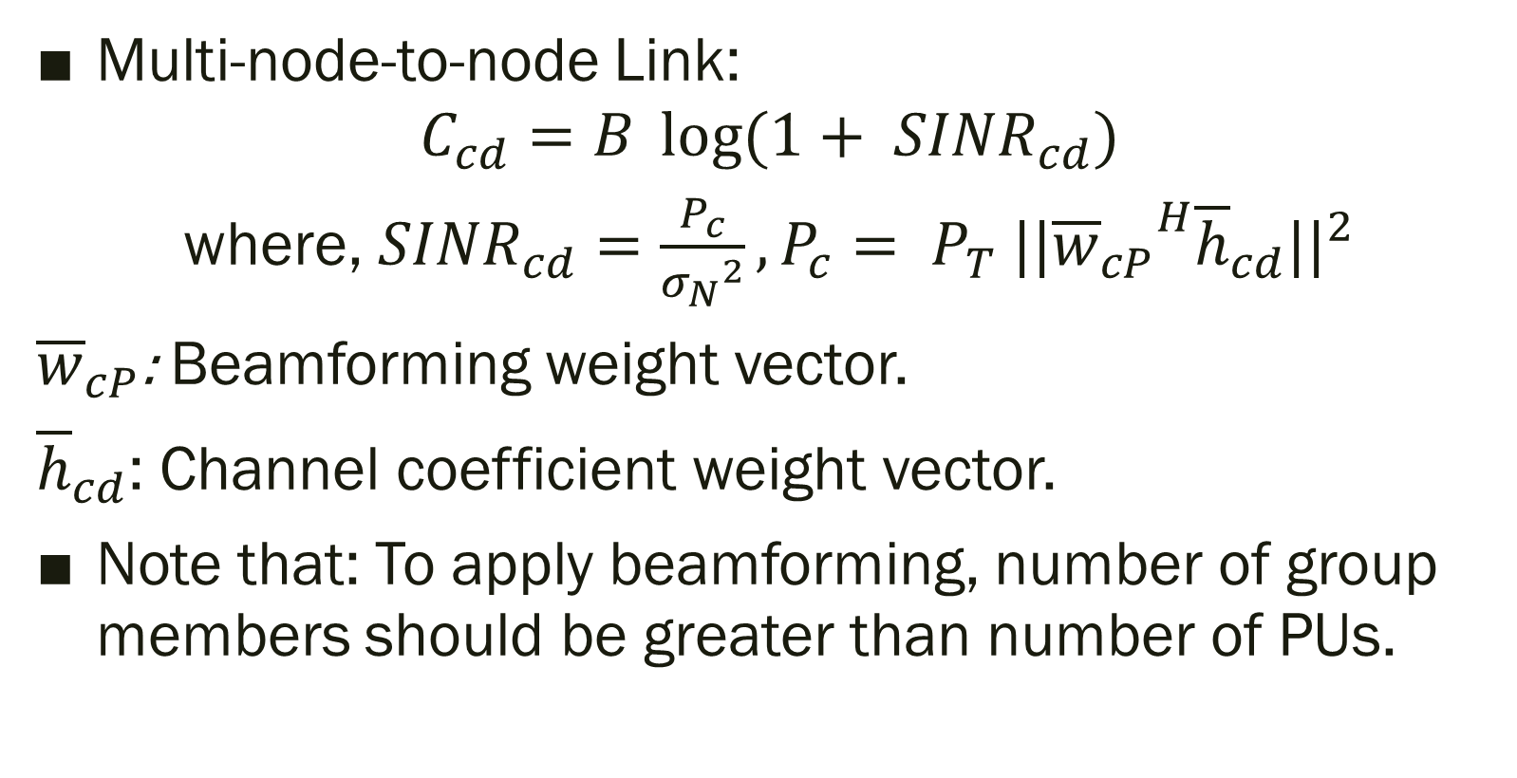
4.2.1 Capacity Calculations (cont’d)
Multi-node-to-node Link:
$$C_{cd}=B \log{(1+ {SINR}_{cd})}$$
where, ${SINR}_{cd}=\frac{P_{c}}{{σ_{N}}^{2}},P_{c}= P_{T} {||{{\overline{w}}_{cP}}^{H}{\overline{h}}_{cd}||}^{2}$
${\overline{w}}_{cP}$: Beamforming weight vector.
${\overline{h}}_{cd}$: Channel coefficient weight vector.
Note that: To apply beamforming, number of group members should be greater than number of PUs.
Notes:
Weights belong to null-space of channel coefficient matrix to all SUs

Slide 30
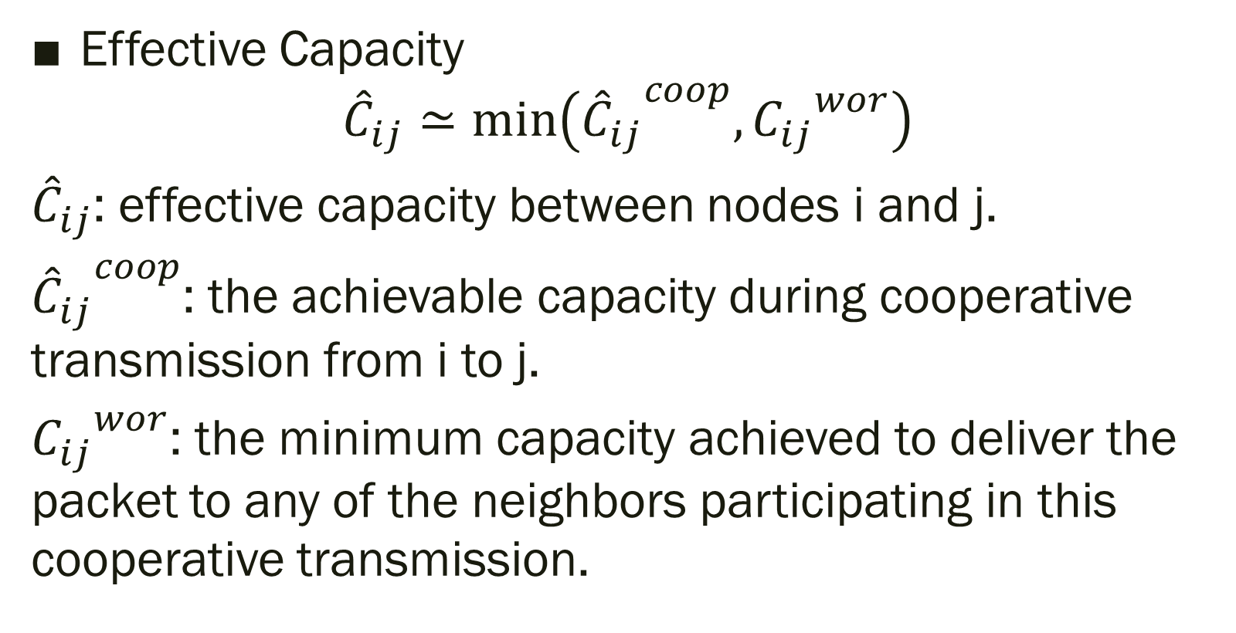
4.2.1 Capacity Calculations (cont’d)
Effective Capacity
$${\hat{C}}_{ij}≃\min\left({{\hat{C}}_{ij}}^{coop},{C_{ij}}^{wor}\right)$$
${\hat{C}}_{ij}$: effective capacity between nodes i and j.
${{\hat{C}}_{ij}}^{coop}$: the achievable capacity during cooperative transmission from i to j.
${C_{ij}}^{wor}$: the minimum capacity achieved to deliver the packet to any of the neighbors participating in this cooperative transmission.

Slide 31
4.2.2 Interference Calculations
Two types of interference can result from constructing cooperative groups:
  Interference on the group itself due to its neighbors.
  Interference due to the group on the neighboring nodes.
For the first type, we delegate congestion resolution to multiple access techniques like CSMA/CA.
Assuming it is fair, the number of flow-carrying nodes in the interference range of the source node/group is inversely proportional to the average achievable capacity over the transmission link.

Slide 32
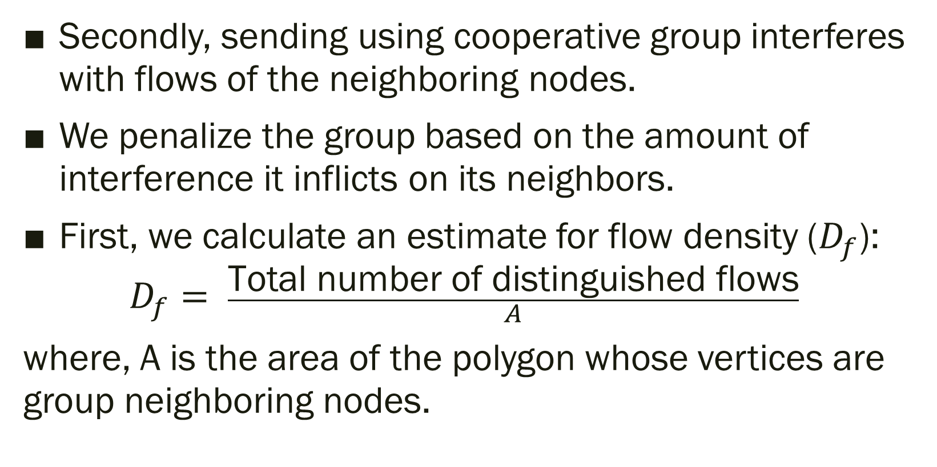
4.2.2 Interference Calculations (cont’d)
Secondly, sending using cooperative group interferes with flows of the neighboring nodes.
We penalize the group based on the amount of interference it inflicts on its neighbors.
First, we calculate an estimate for flow density ($D_{f}$):
$$D_{f}= \frac{\text{Total} \text{number} \text{of} \text{distinguished} \text{fl}\text{ows}}{A}$$
where, A is the area of the polygon whose vertices are group neighboring nodes.

Slide 33
4.2.2 Interference Calculations (cont’d)
To calculate an approximate for the number of flows that will be affected by the group, we calculate the interference range of the constructed group.
We approximate the effective transmission range of the cooperative group as if a single node situated in the center of the group.

Slide 34
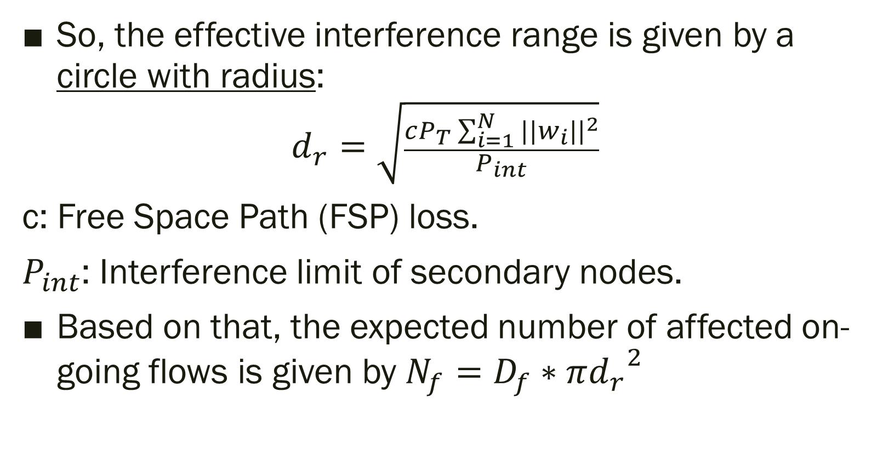
4.2.2 Interference Calculations (cont’d)
So, the effective interference range is given by a circle with radius:
$$d_{r}=\sqrt{\frac{cP_{T}\sum_{i=1}^{N}{{||w_{i}||}^{2}}}{P_{int}}}$$
c: Free Space Path (FSP) loss.
$P_{int}$: Interference limit of secondary nodes.
Based on that, the expected number of affected on-going flows is given by $N_{f}=D_{f}∗π{d_{r}}^{2}$
Notes:
Value of “c” depends on the used frequency

Slide 35
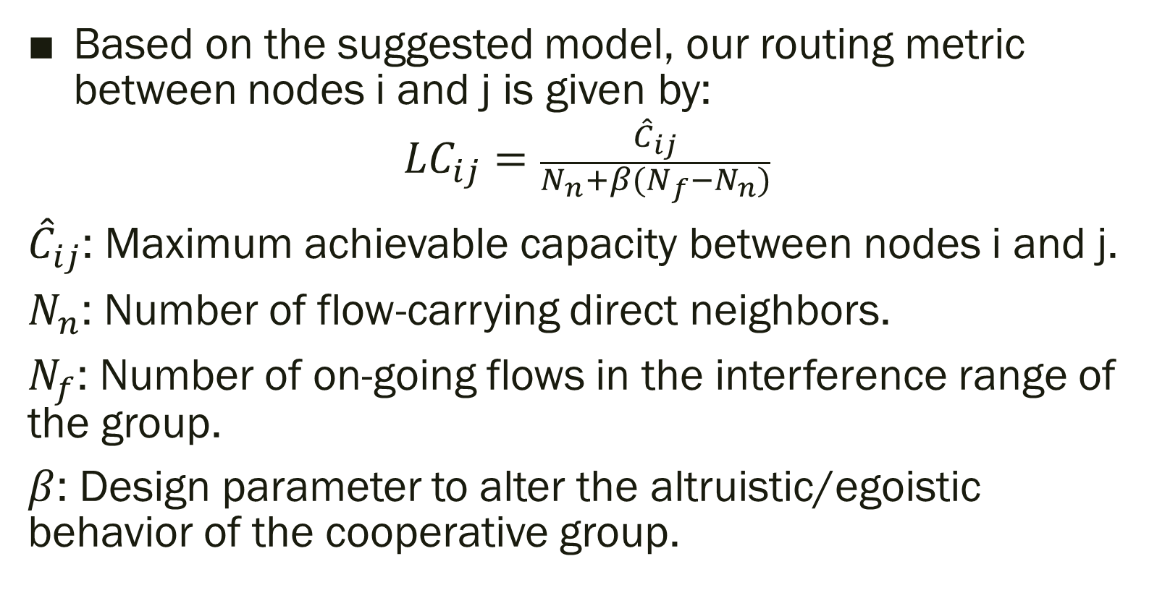
4.3 Routing Metric
Based on the suggested model, our routing metric between nodes i and j is given by:
$${LC}_{ij}=\frac{{\hat{C}}_{ij}}{N_{n}+β(N_{f}−N_{n})}$$
${\hat{C}}_{ij}$: Maximum achievable capacity between nodes i and j.
$N_{n}$: Number of flow-carrying direct neighbors.
$N_{f}$: Number of on-going flows in the interference range of the group.
$β$: Design parameter to alter the altruistic/egoistic behavior of the cooperative group.

Slide 36
Agenda
Introduction
Contributions
Related Work
Undercover: System and Mathematical Models
Undercover: Implementation Details
  Elimination Algorithm
  Route Discovery
  Complete Example
CSCR: Channel Selection Scheme for Undercover
Experimental Results
Conclusions and Future Work

Slide 37
5.1 Elimination algorithm
Group construction algorithm is exponential O(2^{N}).
Several facts that reduce this complexity should be noted.
The number of nodes participating in the cooperative group should be strictly higher than the number of surrounding PUs. This puts restriction on the smallest size for potential groups.

Slide 38
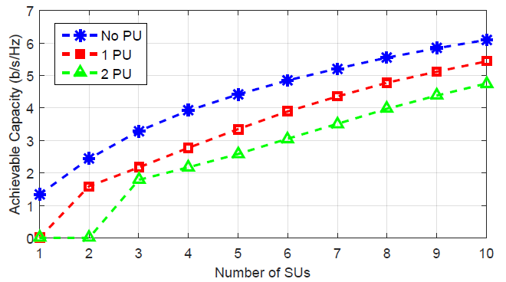
5.1 Elimination algorithm (cont’d)
Based on the wireless fading model, the achievable capacity of a node or cooperative group links can be foreseen to fall in certain regions with high probability.
Achievable capacity increases as well as N_{n}.
Notes:
This figure assumes Rayleigh fading model with unit variance. It depends on statistical analysis.

Slide 39
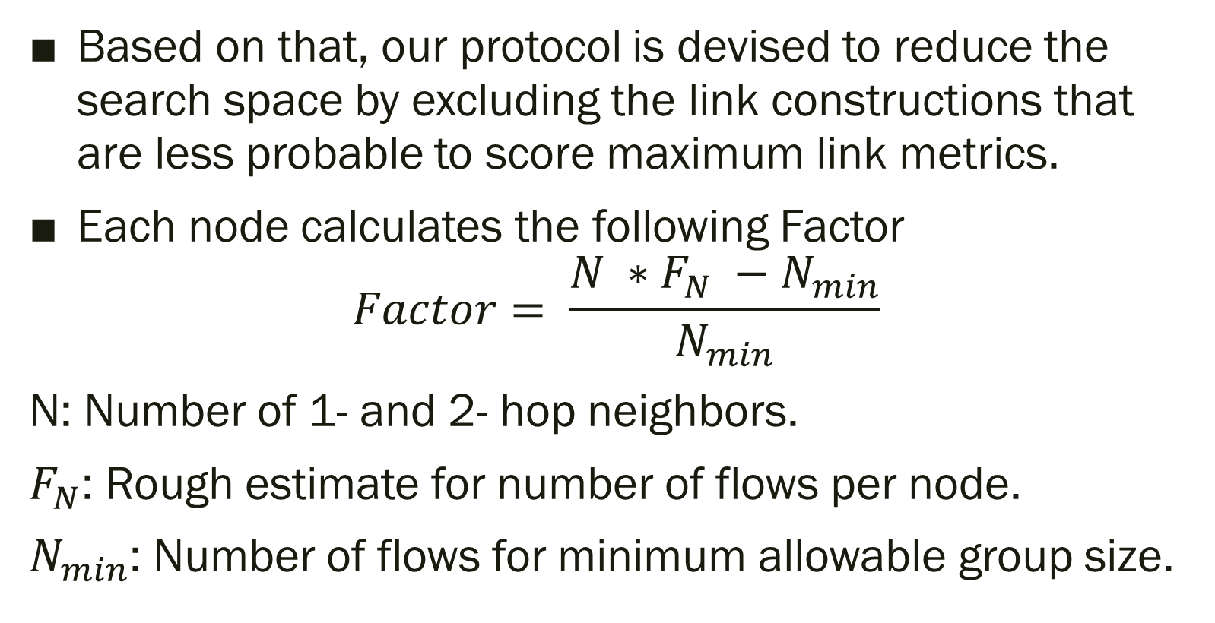
5.1 Elimination algorithm (cont’d)
Based on that, our protocol is devised to reduce the search space by excluding the link constructions that are less probable to score maximum link metrics.
Each node calculates the following Factor
$$Factor= \frac{N ∗F_{N} −N_{min}}{N_{min}}$$
N: Number of 1- and 2- hop neighbors.
$F_{N}$: Rough estimate for number of flows per node.
$N_{min}$: Number of flows for minimum allowable group size.
Notes:
This factor represents the percentage of increase in number of flows that affect the constructed group
Fn = Df / Dn where Df is flow density and Dn is node density

Slide 40
5.1 Elimination algorithm (cont’d)
Comparing this factor to certain thresholds, the algorithm decides whether to increase the group size or not.
This puts an upper limit on the group size.
Notes:
Thresholds based on the given figure

Slide 41
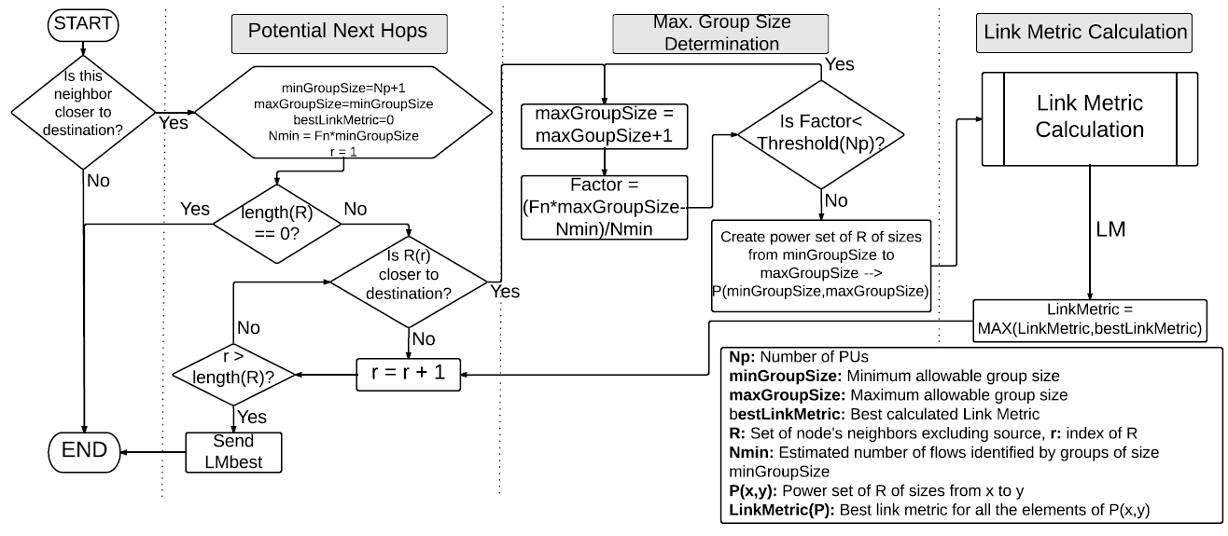
5.2 Route Discovery
Should move closer

Slide 42
5.2 Route Discovery
Loop to search for potential next hop

Slide 43
5.2 Route Discovery
Find max group size according to the mentioned algorithm

Slide 44
5.2 Route Discovery
Find all combinations of allowed group sizes

Slide 45
5.2 Route Discovery
Calculate the routing metric and keep the best

Slide 46
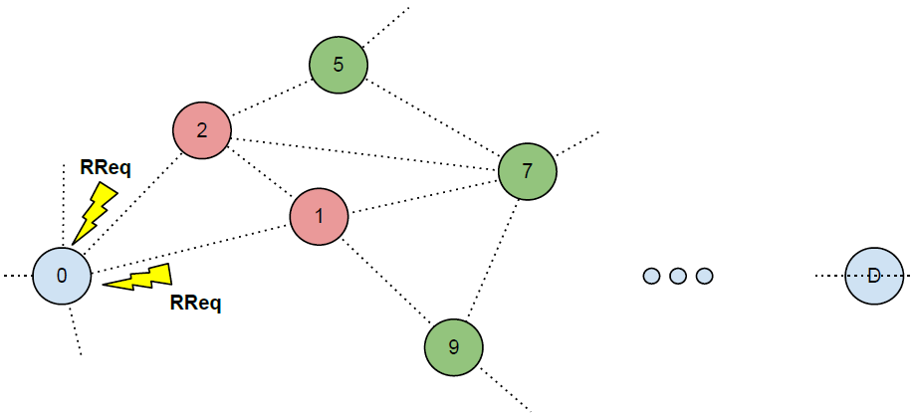
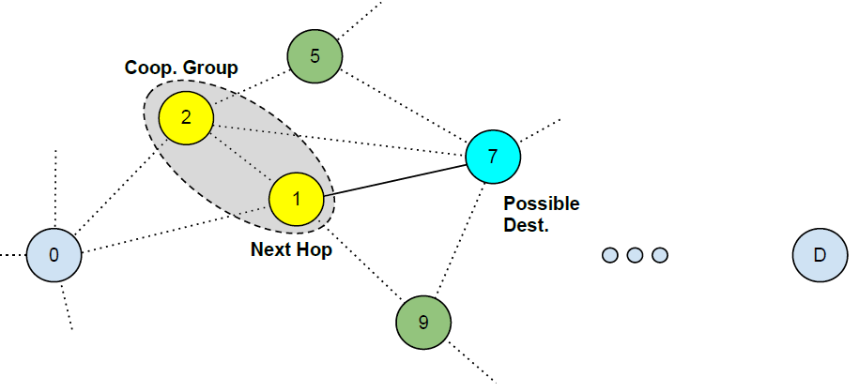
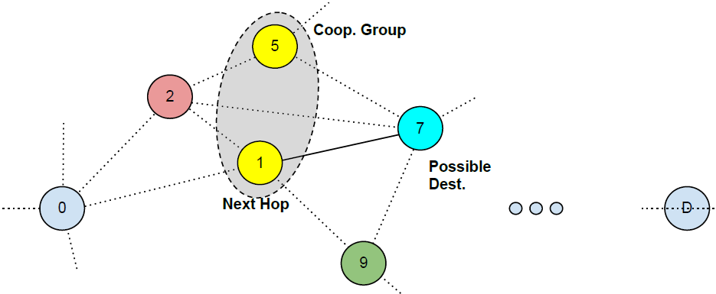
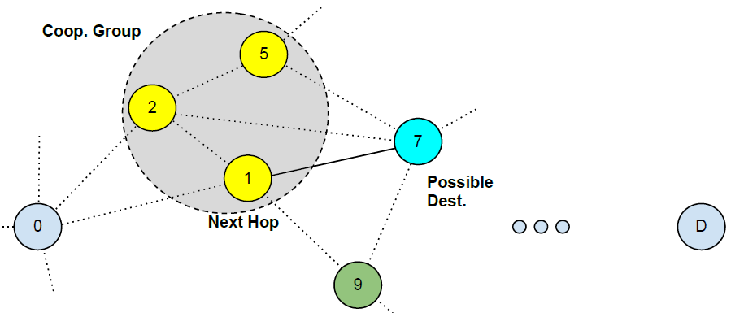
5.3 In-action Example

Slide 47
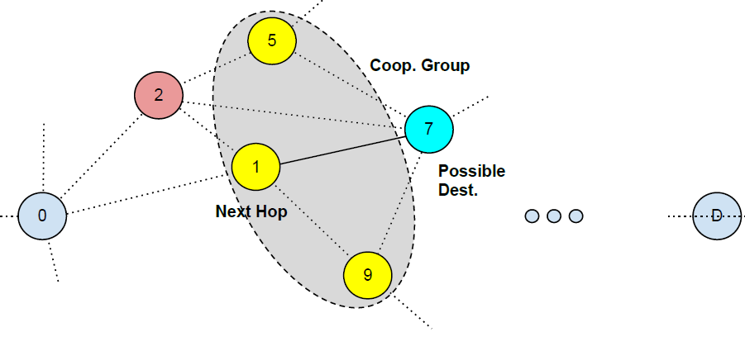
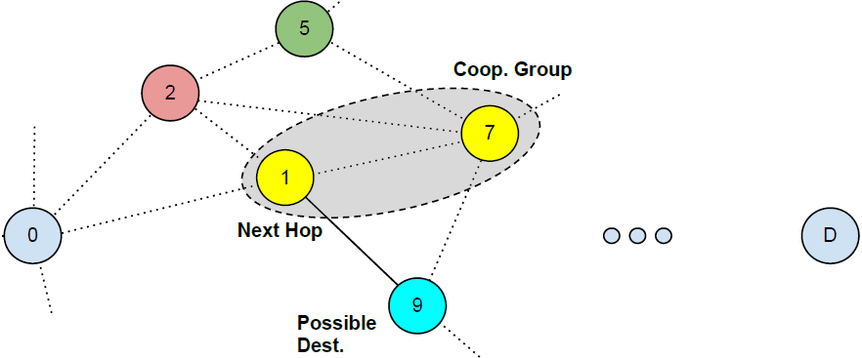
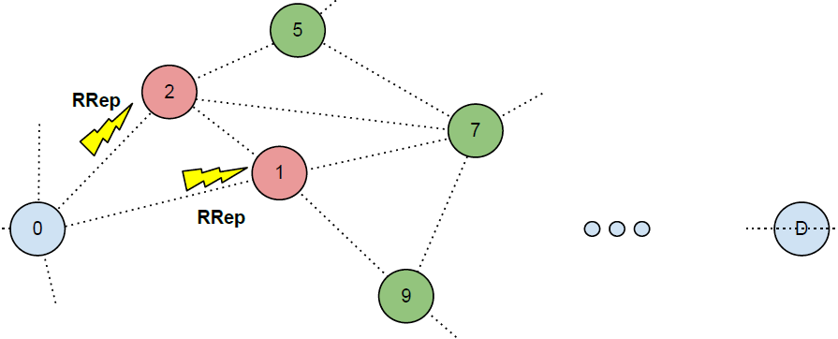
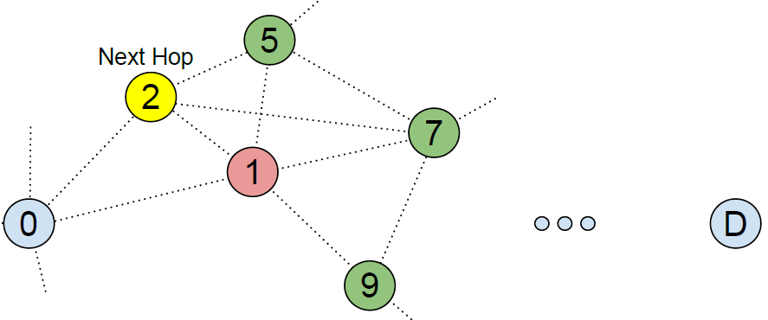
5.3 In-action Example (cont’d)

Slide 48
Agenda
Introduction
Contributions
Related Work
Undercover: System and Mathematical Models
Undercover: Implementation Details
CSCR: Channel Selection Scheme for Undercover
  Design Targets
  Updated Routing Metric
  CSCR Algorithm Flow
Experimental Results
Conclusions and Future Work

Slide 49
6.1 Design Targets
Distributed approach. Each node chooses independently the channel it will use.
Avoid channels congested with large number of active PUs.
Taking into consideration the network changing environment.
Minimize the switching delay as much as possible.
Avoid preempting already-running SUs flows.
Notes:
Changing environment includes changing number of flows, PUs activities, and channels states.

Slide 50
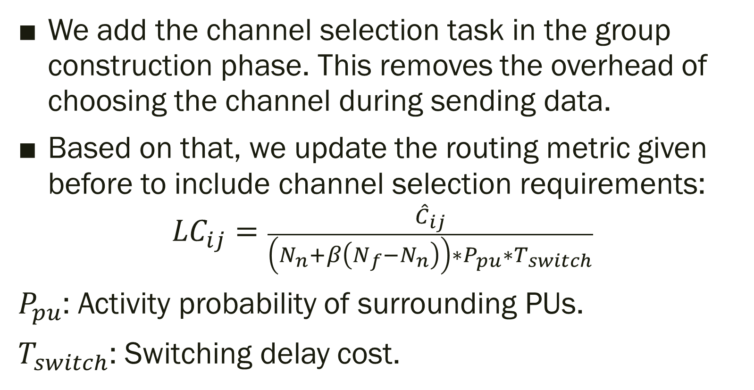
6.2 Updated Routing Metric
We add the channel selection task in the group construction phase. This removes the overhead of choosing the channel during sending data.
Based on that, we update the routing metric given before to include channel selection requirements:
$${LC}_{ij}=\frac{{\hat{C}}_{ij}}{\left(N_{n}+β\left(N_{f}−N_{n}\right)\right)∗P_{pu}∗T_{switch}}$$
$P_{pu}$: Activity probability of surrounding PUs.
$T_{switch}$: Switching delay cost.

Slide 51
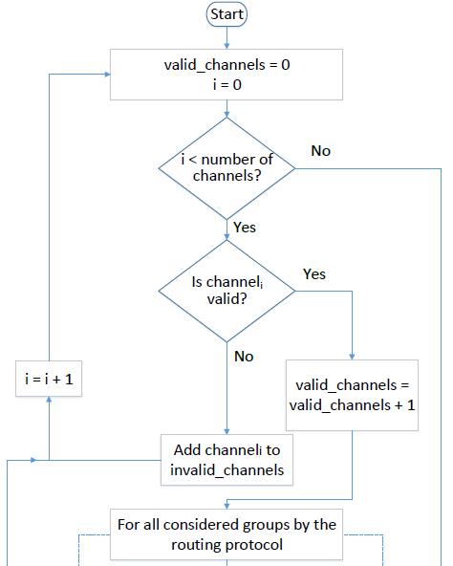
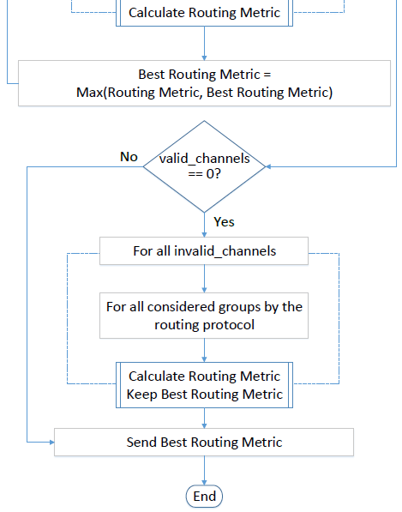
CSCR Algorithm Flow
The old group construction part

Slide 52
CSCR Algorithm Flow
To count valid channels

Slide 53
CSCR Algorithm Flow
Loop on all channels and check if they are valid

Slide 54
CSCR Algorithm Flow
If valid, continue
If invalid, add to list

Slide 55
CSCR Algorithm Flow
If no valid*, try invalid. Else, finish
* rare case

Slide 56
Objectives
Discuss the motivation of this work.
Present the contributions of this work.
Discuss the details of the proposed algorithm.
Discuss the evaluation of the proposed algorithm.
Give directions for possible future extensions to this work.

Slide 57
Agenda
Introduction
Contributions
Related Work
Undercover: System and Mathematical Models
Undercover: Implementation Details
CSCR: Channel Selection Scheme for Undercover
Experimental Results
  Evaluation Metrics
  Undercover Performance Evaluation Results
  CSCR Performance Evaluation Results
Conclusions and Future Work

Slide 58
7.1 Evaluation Metrics
Goodput: number of bits communicated successfully from the source to the destination per second.
Average end-to-end delay: average time taken by packets to reach the destination from the source.
Packet delivery ratio: percentage of packets reached the destination to the total number of packets generated by the source.
Routing overhead: number of transmitted control packets in the routing phase.

Slide 59
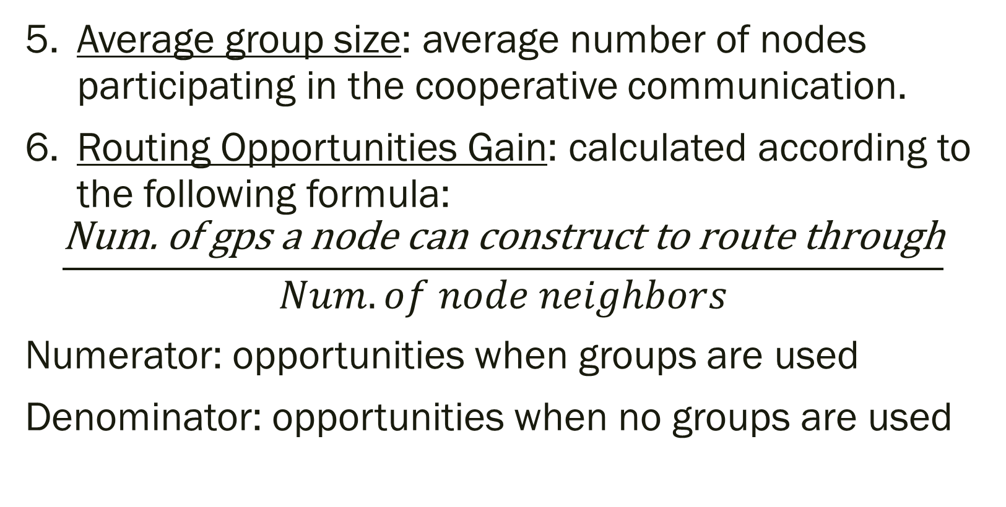
7.1 Evaluation Metrics
Average group size: average number of nodes participating in the cooperative communication.
Routing Opportunities Gain: calculated according to the following formula:
$$\frac{\text{Num}\text{. }\text{of} \text{gps} \text{a} \text{node} \text{can} \text{construct} \text{to} \text{route} \text{through}}{Num. of node neighbors}$$
Numerator: opportunities when groups are used
Denominator: opportunities when no groups are used

Slide 60
7.2 Experimental Results: Undercover
Used NS2 [19] for evaluation.
SUs and PUs are randomly distributed in the deployment area.
ON-OFF model for PUs with exponentially-distributed parameters.
Nodes run IEEE 802.11 MAC protocol.
Only one channel is available for sending data.
Compare against LAUNCH (local protocol) and CAODV (global protocol).

Slide 61
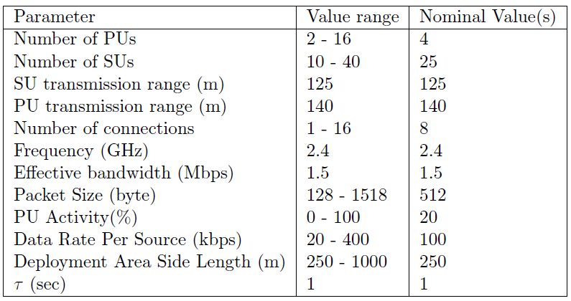
7.2 Undercover: Experiments Parameters
We present only some of the results we obtained.

Slide 62
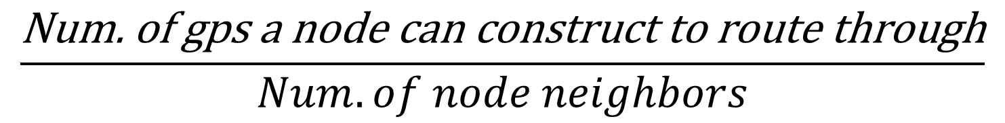
7.2 Undercover Results: number of SUs
$$\frac{\text{Num}\text{. }\text{of} \text{gps} \text{a} \text{node} \text{can} \text{construct} \text{to} \text{route} \text{through}}{Num. of node neighbors}$$
Notes:
LAUNCH takes into consideration opportunistically PUs. Deals with PUs better than CAODV. Also, it chooses least delay routes.
Decreases at nSUs = 40 since not all opportunities are taken into consideration due to the complexity reduction algorithm.

Slide 63
7.2 Undercover Results: PUs Activity
Notes:
Even at zero PUs activity, Undercover is the best due to the use of cooperative diversity.
Delay moves in the same direction of goodput since no packets reach the destination and hence the congestion decreases and delay decreases too.
Delay increases at first part of the graph for some protocols since another factor affect the delay which is: channel switching delay or group construction delay.

Slide 64
7.2 Undercover Results: Routing Overhead

Slide 65
7.2 Undercover Results: Complexity Reduction Algorithm Performance

Slide 66
7.3 Experimental Results: CSCR
This section evaluates Undercover plus CSCR running over it.
We denote this with CSCR only along the section.
The original algorithm without CSCR is denoted with Undercover.
Undercover chooses the sending channel randomly.
We use the same setup built for Undercover.
One difference only: nodes now can operate with multiple channels.

Slide 67
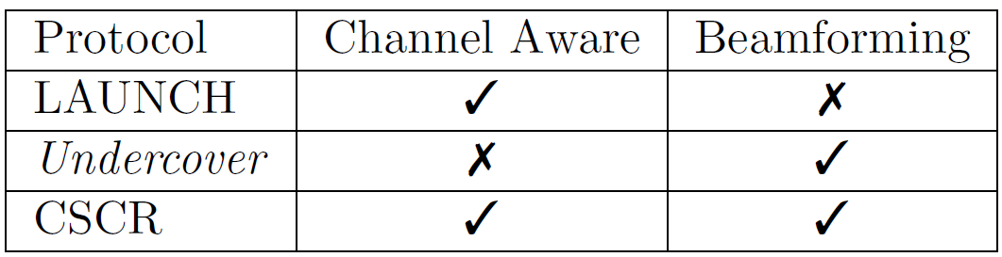
7.3 Experimental Results: CSCR (cont’d)
We compare CSCR against two other protocols since each of them can give us insight on some characteristic in CSCR.

Slide 68
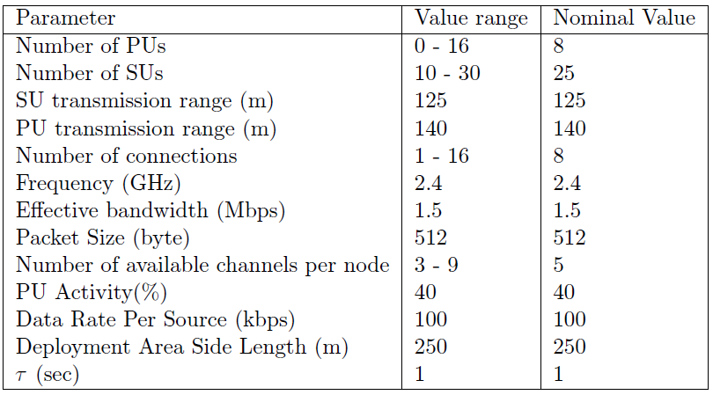
7.3 CSCR: Experiments Parameters
We present only some of the results we obtained.

Slide 69
7.3 CSCR Results: number of Channels
Notes:
LAUNCH remains as it is due to channel locking mechanism.
Undercover cannot use channels well so, goodput decreases with the increase in number of channels since arbitrary choices let it fall with highly active PUs and large switching delays and preemption of flows.
Delay moves with goodput except at 9 channels with CSCR; this is because here number of channels > number of PUs so, there is an opportunity to send without interfering at all with PUs.

Slide 70
7.3 CSCR Results: number of Flows

Slide 71
Objectives
Discuss the motivation of this work.
Present the contributions of this work.
Discuss the details of the proposed algorithm.
Discuss the evaluation of the proposed algorithm.
Give directions for possible future extensions to this work.

Slide 72
Agenda
Introduction
Contributions
Related Work
Undercover: System and Mathematical Models
Undercover: Implementation Details
CSCR: Channel Selection Scheme for Undercover
Experimental Results
Conclusions and Future Work
  Conclusions
  Possible Future Extensions

Slide 73
8.1 Conclusions
Investigated the use of cooperative communication techniques in route discovery for Cognitive Radio Networks.
Using beamforming, secondary users can transmit data even if primary users are active through nulling the transmission at the latter.
Using cooperative diversity, throughput of secondary flows can be enhanced through increasing the transmission power when sending as a group.

Slide 74
8.1 Conclusions (cont’d)
Undercover is designed to be an interference-aware protocol so, it considers interference inflicted on the neighboring nodes and interference from on-going flows on the group members.
A complexity reduction algorithm was proposed to shrink search space for group construction phase.
A channel selection scheme was proposed to be integrated with the suggested routing protocol.

Slide 75
8.1 Conclusions (cont’d)
Channel selection is integrated in the group construction algorithm.
The best channel is the one that experiences the least switching delay and primary users activities.
NS2 simulations were held to evaluate both Undercover and CSCR.
Experiments show that using Undercover can enhance goodput by 250% and using CSCR can enhance it with 150% more gain.

Slide 76
8.2 Future Possible Extensions
Extend the protocol to send data to multicast group.
Improving the group construction complexity.
Finding a mathematical formula for the relation between the achievable capacity and group size.

Slide 77
8.2 Future Possible Extensions (cont’d)
Investigating the effect of mobility on the cooperative routing and the channel selection.
Investigate using another spectrum contention resolution mechanism.
Implement Undercover and CSCR on real testbeds like CRC [20], CogFrame [21], and CRESCENT [22].

Slide 78
Objectives
Discuss the motivation of this work.
Present the contributions of this work.
Discuss the details of the proposed algorithm.
Discuss the evaluation of the proposed algorithm.
Give directions for possible future extensions to this work.

Slide 79
References
[1] FCC Spectrum Policy Task Force. Report of the spectrum efficiency working group, 2002.
[2] Marja Matinmikko, Miia Mustonen, Dennis Roberson, Jarkko Paavola, Marko Hoyhtya, Seppo Yrjola, and Juha Roning. Overview and comparison of recent spectrum sharing approaches in regulation and research: From opportunistic unlicensed access towards licensed shared access. In Dynamic Spectrum Access Networks (DYSPAN), 2014 IEEE International Symposium on, pages 92-102, 2014.
[3] Moustafa Youssef, Mohammad Ibrahim, Mohamed Abdelatif, Lin Chen, and Athanasios V Vasilakos. Routing metrics of cognitive radio networks: A survey. Communications Surveys & Tutorials, IEEE, 16(1):92-109, 2014.
[4] Andrea Goldsmith, Syed Ali Jafar, Ivana Maric, and Sudhir Srinivasa. Breaking spectrum gridlock with cognitive radios: An information theoretic perspective. Proceedings of the IEEE, 97(5):894-914, 2009.
[5] Sriram Lakshmanan and Raghupathy Sivakumar. Diversity routing for multi-hop wireless networks with cooperative transmissions. In IEEE SECON, pages 1-9, 2009.
[6] Christopher J Collier and Robert J Murray. Transmission system for sending two signals simultaneously on the same communications channel, December 17 1991. US Patent 5,073,899.

Slide 80
References
[7] Amir E Khandani, Eytan Modiano, Jinane Abounadi, and Lizhong Zheng. Cooperative routing in wireless networks. In Advances in Pervasive Computing and Networking, pages 97-117. Springer, 2005.
[8] Qian Zhang, Juncheng Jia, and Jin Zhang. Cooperative relay to improve diversity in cognitive radio networks. IEEE Communications Magazine, 47(2):111-117, 2009.
[9] Lei Ding, Tommaso Melodia, Stella N Batalama, and John D Matyjas. Distributed routing, relay selection, and spectrum allocation in cognitive and cooperative ad hoc networks. In 2010 7th Annual IEEE Communications Society Conference on Sensor Mesh and Ad Hoc Communications and Networks (SECON), pages 1-9.
[10] Tao Yi, Li Guo, Kai Niu, Hongyan Cai, Jiaru Lin, and Wenbao Ai. Cooperative beamforming in cognitive radio network with hybrid relay. In 19th International Conference on Telecommunications (ICT), pages 1-5. IEEE, 2012.
[11] Mohammed Karmoose, Karim Habak, Mustafa ElNainay, and Moustafa Youssef. Dead zone penetration protocol for cognitive radio networks. In Wireless and Mobile Computing, Networking and Communications (WiMob), 9th International Conference on, pages 529-536. IEEE, 2013.

Slide 81
References
[12] Deepak R Joshi, Dimitrie C Popescu, and Octavia A Dobre. Joint spectral shaping and power control in spectrum overlay cognitive radio systems. Communications, IEEE Transactions on, 60(9):2396-2401, 2012.
[13] Anh Tuan Hoang, Ying-Chang Liang, and Md Habibul Islam. Power control and channel allocation in cognitive radio networks with primary users' cooperation. Mobile Computing, IEEE Transactions on, 9(3):348-360, 2010.
[14] Haythem Ahmad Bany Salameh. Throughput-oriented channel assignment for opportunistic spectrum access networks. Mathematical and Computer Modelling, 53(11):2108-2118, 2011.
[15] Won-Yeol Lee and Ian F Akyldiz. A spectrum decision framework for cognitive radio networks. Mobile Computing, IEEE Transactions on, 10(2):161{174, 2011.
[16] Wooseong Kim, Andreas J Kassler, Marco Di Felice, and Mario Gerla. Urban-x: towards distributed channel assignment in cognitive multi-radio mesh networks. In Wireless Days (WD), 2010 IFIP, pages 1-5. IEEE, 2010.
[17] Shu Chen, Yan Huang, and Kamesh Namuduri. A factor graph based dynamic spectrum allocation approach for cognitive network. In Wireless Communications and Networking Conference (WCNC), 2011 IEEE, pages 850-855. IEEE, 2011.
[18] Husheng Li and Lijun Qian. Enhancing the reliability of cognitive radio networks via channel assignment: Risk analysis and redundancy allocation. In Information Sciences and Systems (CISS), 2010 44th Annual Conference on, pages 1-6. IEEE, 2010.

Slide 82
References
[19] S. Floyd S. McCanne. NS network simulator. http://www.w3schools.com/browsers/browsers os.asp.
[20] Samer S Hanna, Arsany Guirguis, Mahmoud A Mahdi, Yaser A El-Nakieb, Mahmoud Alaa Eldin, and Dina M Saber. Crc: collaborative research and teaching testbed for wireless communications and networks. In Proceedings of the Tenth ACM International Workshop on Wireless Network Testbeds, Experimental Evaluation, and Characterization, pages 73-80. ACM, 2016.
[21] Ahmed Saeed, Mohammad Ibrahim, Khaled Harras, Moustafa Youssef, et al. A low-cost large-scale framework for cognitive radio routing protocols testing. In Communications (ICC), International Conference on, pages 2900-2904. IEEE, 2013.
[22] Abdelrahman Asal, Ahmad Mamdouh, Ahmed Salama, Moamen Elgendy, Moamen Mokhtar, Muhammed Elsayed, and Moustafa Youssef. Crescent: a modular cost-ecient open-access testbed for cognitive radio networks routing protocols. In Proceedings of the 19th annual international conference on Mobile computing & networking, pages 179-182. ACM, 2013.

Slide 83
Questions?

